Slide 1
Chapter 10
ADVANCE DATA MANIPULATION LANGUAGE
(SQL Function)

Slide 2
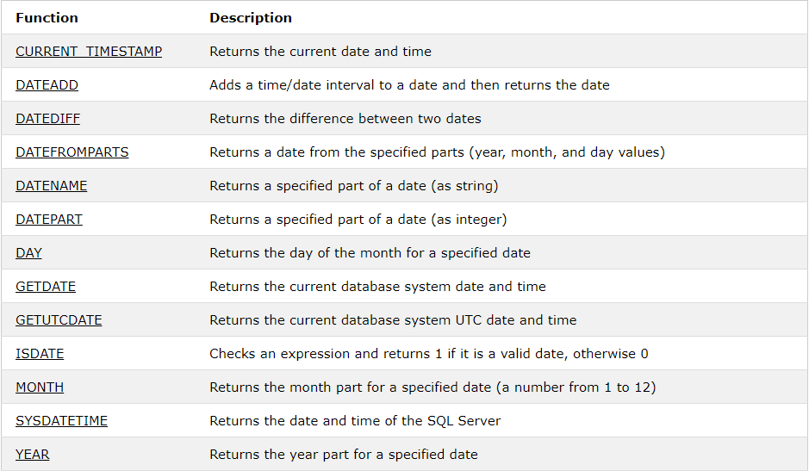
10.1. Data and time functions

Slide 3
Example:
1. Current Timestamp
SELECT CURRENT_TIMESTAMP
2. DateAdd
SELECT DATEADD(Day, 1, ‘2019/12/25') AS DateAdd
SELECT DATEADD(Month, 1, ‘2019/12/25') AS DateAdd
SELECT DATEADD(Year, 1, ‘2019/12/25') AS DateAdd
SELECT DATEADD(month, -2, ’2019/12/25') AS DateAdd
SELECT LastName, BirthDate, DATEADD(year, 18, BirthDate) AS DateAdd
FROM tbEmployees
3. DateDiff
SELECT DATEDIFF(year, ’2019/08/25', ’2010/08/25') AS DateDiff
SELECT DATEDIFF(month, '2017/08/25', '2011/08/25') AS DateDiff

Slide 4
Example:
4. DateFromParts
SELECT DATEFROMPARTS(2018, 10, 31) AS DateFromParts
5. DateName
SELECT DATENAME(year, '2017/08/25') AS DatePartString
SELECT DATENAME(month, '2017/08/25') AS DatePartString
6. DatePart
SELECT DATEPART(yy, '2017/08/25') AS DatePartInt
SELECT DATEPART(month, '2017/08/25') AS DatePartInt
7. Day
SELECT DAY('2017/08/25') AS DayOfMonth
8. GetDate
SELECT GETDATE()

Slide 5
Example:
9. IsDate
SELECT ISDATE('2017-08-25’)
SELECT ISDATE('2017’)
SELECT ISDATE('Hello world!’)
10. Month
SELECT MONTH('2017/08/25') AS [Month]
11. SysDateTime
SELECT SYSDATETIME() AS [SysDateTime]
12. Year
SELECT YEAR('1998/05/25 09:08') AS Year

Slide 6
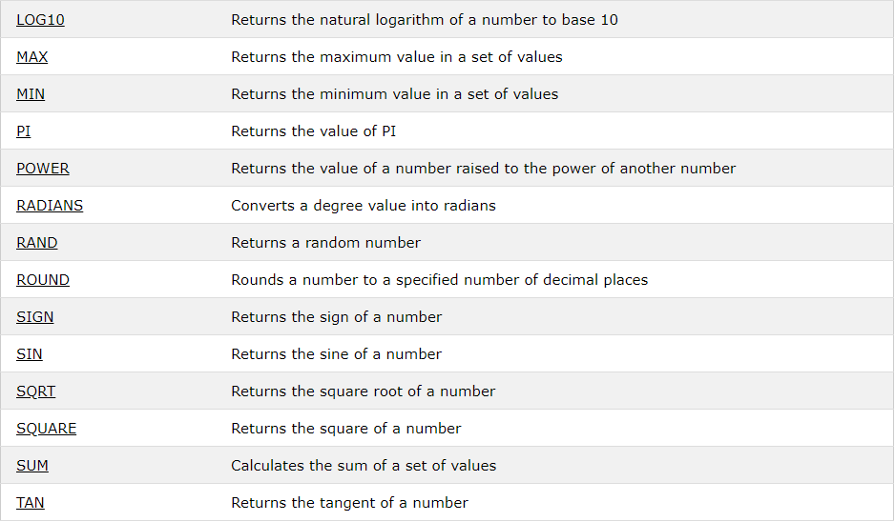
10.2. Numeric Functions

Slide 7
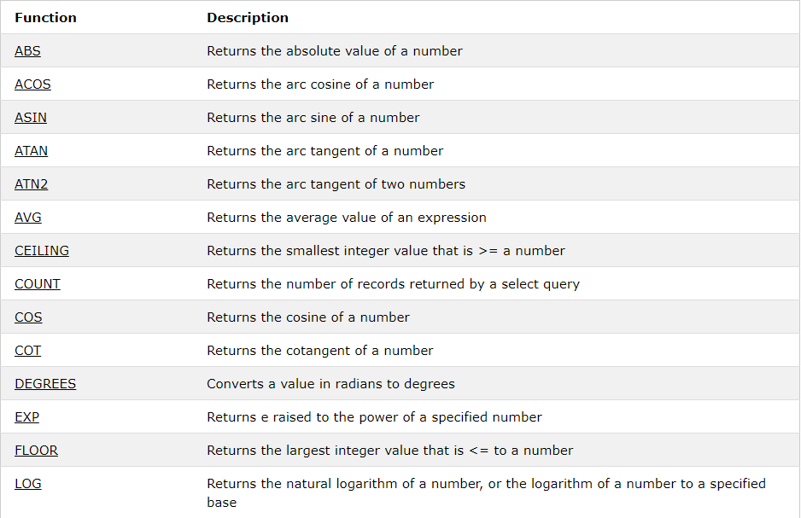

Slide 8
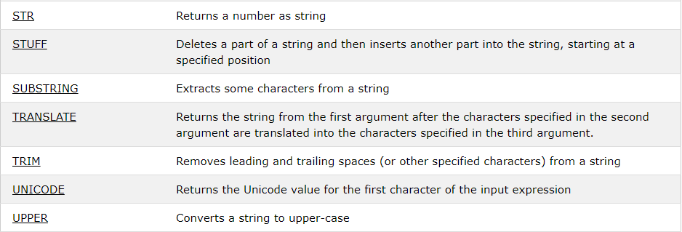
10.3. String Functions

Slide 9
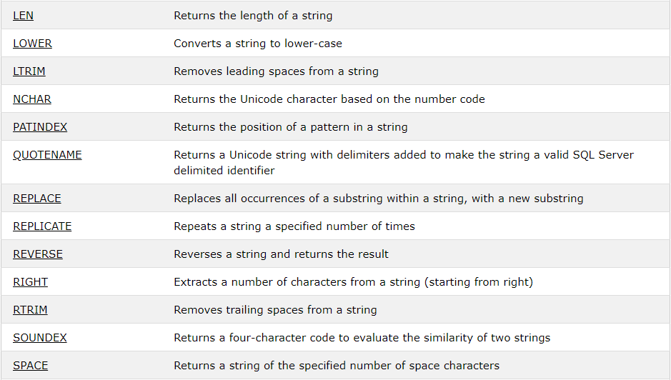

Slide 10
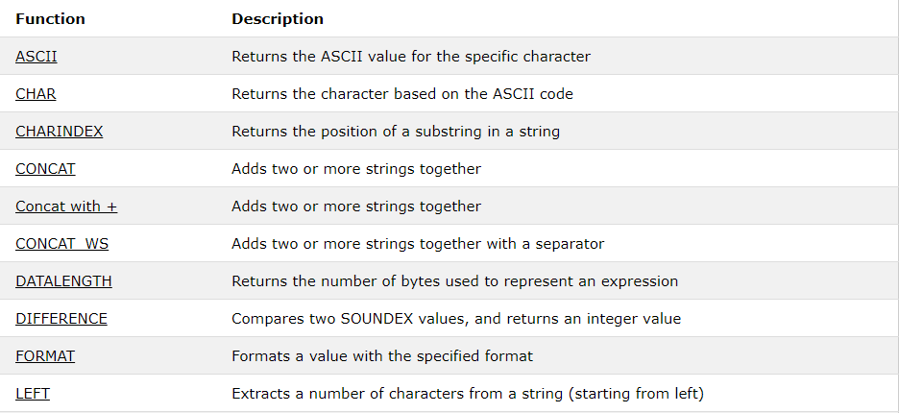

Slide 11
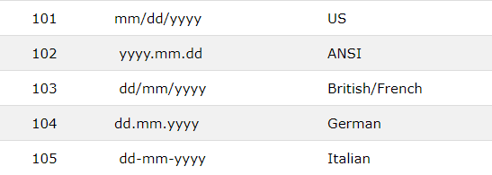
10.4. convert function
Syntax:
CONVERT(data_type(length), expression, style)
Example:
SELECT CONVERT(varchar, 25.65)
SELECT CONVERT(datetime, '2017-08-25’)
SELECT CONVERT(varchar, '2017-08-25', 101)

